Slide 1
Analyzing the German Public Procurement Network Structure
Implications for corruption risk using single bidder rates
10 May 2023
Ma. Adelle Gia Arbo
Master of Data Science for Public Policy
m.arbo@students.hertie-school.org
GitHub: adellegia/network-analysis-EU-procurements

Slide 2
Agenda
1
Motivation
German Public Procurement Network: analyzing corruption risk
2
Summary statistics
Density, local clustering, degree heterogeneity
3
k-core analysis & Community detection
Centralization and corruption, greedy algorithm
4
Hubs
Disassortativity and centrality
5
Policy implications
Main findings and future work

Slide 3





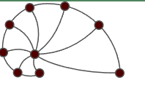
Motivation
1
2
3
4
5
German Public Procurement Network: analyzing corruption risk
Motivation
Public contracts are susceptible to corruption, fraud, and anticompetitive conduct
public procurement market
Research questions
Is there a risk of corruption in centralized contracts?
How does it develop over time?
- a bipartite network
public contracts
In 2008-2016, on average, >30,000 contracts b/w ~19,000 issuers and ~15,000 winners
Issuers
Winners
Analysis
single-bidding rate
proxy of corruption risk,
rate at which a contract attracted only a single bidder
Buyers –
public institutions (e.g., ministries, city halls)
Suppliers – private firms providing goods and services
Data source:
Netzschleuder
eu_procurements_alt
Data from Tenders Electronic Daily
Available for 26 EU member states
Notes:
Objectives:
To describe the network of public procurement contracts in Germany from 2008 to 2016.
To understand the structure of the German market in relation to corruption risk across years.

Slide 4
Summary statistics
1
2
3
4
5
Largest connected components 2008-2016
Year | Contracts | Nodes | Winners | Issuers | Density | R-A clust. | μ(Deg_{W}) | σ(Deg_{W}) | μ(Deg_{I}) | σ(Deg_{I} )
2008 | 16,639 | 11,168 | 9,143 | 2,025 | 0.00027 | 0.01 | 1.82 | 2.67 | 8.22 | 17.02
2009 | 20,935 | 13,004 | 10,526 | 2,478 | 0.00025 | 0.01 | 1.99 | 5.37 | 8.45 | 20.26
2010 | 27,560 | 14,663 | 12,209 | 2,454 | 0.00026 | 0.02 | 2.26 | 11.86 | 11.23 | 48.78
2011 | 25,705 | 15,000 | 12,451 | 2,549 | 0.00023 | 0.02 | 2.06 | 3.57 | 10.08 | 21.13
2012 | 29,014 | 16,393 | 13,631 | 2,762 | 0.00022 | 0.02 | 2.13 | 4.27 | 10.50 | 25.24
2013 | 31,546 | 17,105 | 14,100 | 3,005 | 0.00022 | 0.02 | 2.24 | 4.83 | 10.50 | 25.61
2014 | 34,644 | 17,642 | 14,689 | 2,953 | 0.00022 | 0.04 | 2.36 | 6.18 | 11.73 | 32.43
2015 | 38,208 | 19,557 | 16,232 | 3,325 | 0.00020 | 0.05 | 2.35 | 5.62 | 11.49 | 29.67
2016 | 42,656 | 21,879 | 18,011 | 3,868 | 0.00018 | 0.05 | 2.37 | 5.63 | 11.03 | 28.19
Ave. | 29,656 | 16,268 | 13,444 | 2,824 | 0.00023 | 0.03 | 2.18 | 5.56 | 10.36 | 27.59
Total | 266,907
Notes:
RA=number of cycles of length four in the network/number of paths of length three
Measure of local correlation
The expected Robins–Alexander clustering of random bipartite networks tends to their density as they get large.
Observed clustering is an order of magnitude greater than the density of the observed networks

Slide 5
Summary statistics
1
2
3
4
5
Largest connected components 2008-2016
Year | Contracts | Nodes | Winners | Issuers | Density | R-A clust. | μ(Deg_{W}) | σ(Deg_{W}) | μ(Deg_{I}) | σ(Deg_{I} )
2008 | 16,639 | 11,168 | 9,143 | 2,025 | 0.00027 | 0.01 | 1.82 | 2.67 | 8.22 | 17.02
2009 | 20,935 | 13,004 | 10,526 | 2,478 | 0.00025 | 0.01 | 1.99 | 5.37 | 8.45 | 20.26
2010 | 27,560 | 14,663 | 12,209 | 2,454 | 0.00026 | 0.02 | 2.26 | 11.86 | 11.23 | 48.78
2011 | 25,705 | 15,000 | 12,451 | 2,549 | 0.00023 | 0.02 | 2.06 | 3.57 | 10.08 | 21.13
2012 | 29,014 | 16,393 | 13,631 | 2,762 | 0.00022 | 0.02 | 2.13 | 4.27 | 10.50 | 25.24
2013 | 31,546 | 17,105 | 14,100 | 3,005 | 0.00022 | 0.02 | 2.24 | 4.83 | 10.50 | 25.61
2014 | 34,644 | 17,642 | 14,689 | 2,953 | 0.00022 | 0.04 | 2.36 | 6.18 | 11.73 | 32.43
2015 | 38,208 | 19,557 | 16,232 | 3,325 | 0.00020 | 0.05 | 2.35 | 5.62 | 11.49 | 29.67
2016 | 42,656 | 21,879 | 18,011 | 3,868 | 0.00018 | 0.05 | 2.37 | 5.63 | 11.03 | 28.19
Ave. | 29,656 | 16,268 | 13,444 | 2,824 | 0.00023 | 0.03 | 2.18 | 5.56 | 10.36 | 27.59
Total | 266,907
Robins-Alexander clustering
R-A >> density
- presence of local correlations
i1
w1
i2
w2
Note: The expected R-A of random bipartite networks tends to their density as they get large.
Given: w1 wins contracts from i1 and i2
w2 wins a contract from i1
R-A = prob. w2 also wins a contract from i2
Notes:
RA=number of cycles of length four in the network/number of paths of length three
Measure of local correlation
The expected Robins–Alexander clustering of random bipartite networks tends to their density as they get large.
Observed clustering is an order of magnitude greater than the density of the observed networks

Slide 6

Summary statistics
1
2
3
4
5
Largest connected components 2008-2016
Year | Contracts | Nodes | Winners | Issuers | Density | R-A clust. | μ(Deg_{W}) | σ(Deg_{W}) | μ(Deg_{I}) | σ(Deg_{I} )
2008 | 16,639 | 11,168 | 9,143 | 2,025 | 0.00027 | 0.01 | 1.82 | 2.67 | 8.22 | 17.02
2009 | 20,935 | 13,004 | 10,526 | 2,478 | 0.00025 | 0.01 | 1.99 | 5.37 | 8.45 | 20.26
2010 | 27,560 | 14,663 | 12,209 | 2,454 | 0.00026 | 0.02 | 2.26 | 11.86 | 11.23 | 48.78
2011 | 25,705 | 15,000 | 12,451 | 2,549 | 0.00023 | 0.02 | 2.06 | 3.57 | 10.08 | 21.13
2012 | 29,014 | 16,393 | 13,631 | 2,762 | 0.00022 | 0.02 | 2.13 | 4.27 | 10.50 | 25.24
2013 | 31,546 | 17,105 | 14,100 | 3,005 | 0.00022 | 0.02 | 2.24 | 4.83 | 10.50 | 25.61
2014 | 34,644 | 17,642 | 14,689 | 2,953 | 0.00022 | 0.04 | 2.36 | 6.18 | 11.73 | 32.43
2015 | 38,208 | 19,557 | 16,232 | 3,325 | 0.00020 | 0.05 | 2.35 | 5.62 | 11.49 | 29.67
2016 | 42,656 | 21,879 | 18,011 | 3,868 | 0.00018 | 0.05 | 2.37 | 5.63 | 11.03 | 28.19
Ave. | 29,656 | 16,268 | 13,444 | 2,824 | 0.00023 | 0.03 | 2.18 | 5.56 | 10.36 | 27.59
Total | 266,907
Robins-Alexander clustering
R-A >> density
- presence of local correlations
i1
w1
i2
w2
The bipartite network has a rich structure deviating from random behavior.
Given: w1 wins contracts from i1 and i2
w2 wins a contract from i1
R-A = prob. w2 also wins a contract from i2
Notes:
RA=number of cycles of length four in the network/number of paths of length three
Measure of local correlation
The expected Robins–Alexander clustering of random bipartite networks tends to their density as they get large.
Observed clustering is an order of magnitude greater than the density of the observed networks

Slide 7
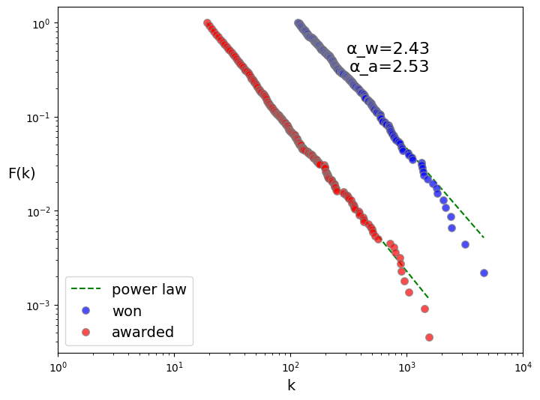
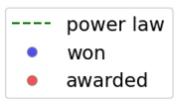
Degree heterogeneity
1
2
3
4
5
Largest connected components 2008-2016
Fit distribution of contracts awarded and won across years to Power law
α ϵ (2, 3)
heterogeneous distribution
Some rare issuers and winners involved in >1000 contracts (hubs); majority are involved in only a few contracts

Slide 8
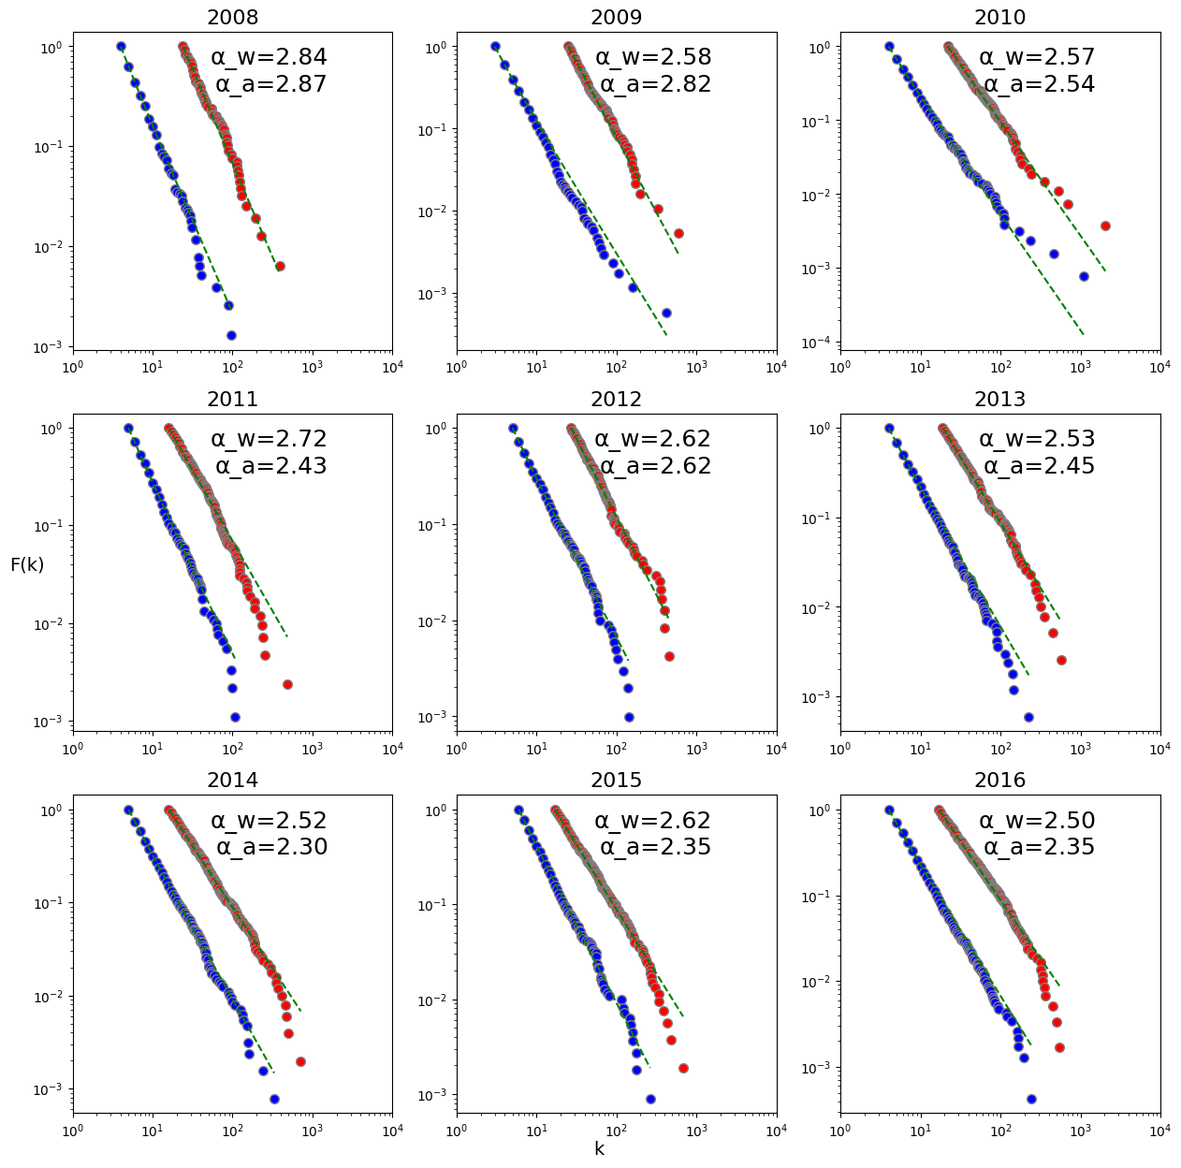
Degree heterogeneity
Largest connected components 2008-2016
Fit distribution of contracts awarded and won across years to Power law
α ϵ (2, 3)
heterogeneous distribution
Some rare issuers and winners involved in >1000 contracts (hubs); majority are involved in only a few contracts
The public procurement networks exhibit characteristics of a scale-free network.
Notes:
a larger number of nodes w/ a small degree; a smaller number of nodes w/ a large degree

Slide 9
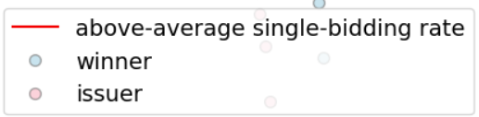
k-core analysis
1
2
3
4
5
k-core decomposition method
Building on Wachs et al., 2020, use k-core decomposition method to highlight the most central and active issuers and winners
Goal:
To identify nodes having at least k=3 or 4
To compute the average single-bidding rates in the cores (proxy of corruption risk = 1 if no competition)
Wachs, J., Fazekas, M., & Kertész, J. (2021). Corruption risk in contracting markets: a network science perspective. International Journal of Data Science and Analytics, 12, 45-60.
Notes:
The k-core decomposition method identifies the largest subgraph in which all nodes have at least degree k.
This is achieved by iteratively removing nodes with degree less than k until no such nodes remain. In this paper, the k-core is preferred due to its simplicity, robustness, and efficiency (i.e., identifies a single maximal core rather than multiple shells, is robust to the presence of hubs, and has fewer recursive steps)
K=3 for 2008,2009,2011 else K=4

Slide 10
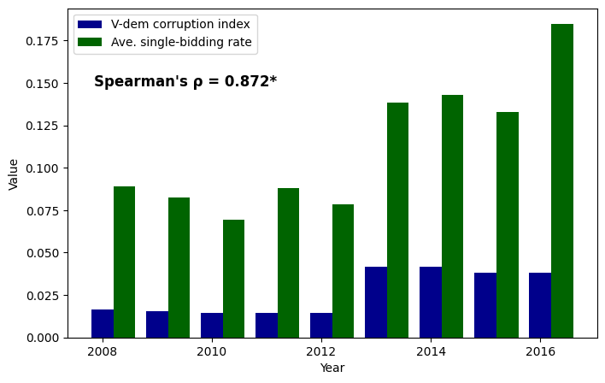
k-core analysis
1
2
3
4
5
Correlation of single-bidding to corruption
*0.05 level of significance (p-value=.002 )
Positive and significant correlation of annual ave. single-bidding rate and corruption index in the cores.
Wachs, J., Fazekas, M., & Kertész, J. (2021). Corruption risk in contracting markets: a network science perspective. International Journal of Data Science and Analytics, 12, 45-60.
Notes:
Correlation insignificant to ave. single-bidding rate in the largest connected components.
Varieties of Democracy (V-Dem) corruption index averages:
the executive corruption measure (v2x_execorr),
public sector corruption measure (v2x_pubcorr)
measure for legislative corruption
measure for judicial corruption (v2jucorrdc).
5-McMann-et-al_A.pdf (unc.edu)
About – V-Dem

Slide 11
Community detection
1
2
3
4
5
Greedy algorithm on k-cores
Year | # Comms | Modularity | highest μ(sbr) of a comm.
2008 | 10 | 0.59 | 0.58
2009 | 12 | 0.55 | 0.38
2010 | 6 | 0.49 | 0.16
2011 | 12 | 0.52 | 0.30
2012 | 6 | 0.54 | 0.19
2013 | 6 | 0.50 | 0.33
2014 | 6 | 0.56 | 0.28
2015 | 8 | 0.52 | 0.50
2016 | 8 | 0.55 | 0.26
Ave. | 8.22 | 0.53 | 0.33
nodes w/in same community are interconnected
Single-bidding is overrepresented among the edges of some clusters.
Notes:
6-12 communities
Modularity >= 0.5
edges are much more likely to be between nodes of the same community rather than across communities
topological clustering across years

Slide 12
Summary statistics
1
2
3
4
5
k-core subgraphs 2008-2016
Year | Contracts | Nodes | Winners | Issuers | Density | R-A clust. | μ(Deg_{W}) | σ(Deg_{W}) | μ(Deg_{I}) | σ(Deg_{I} ) | CV(sbr)
2008 | 1,179 | 516 | 289 | 227 | 0.00887 | 0.07 | 4.08 | 2.33 | 5.19 | 3.32 | 1.44
2009 | 2,221 | 866 | 477 | 389 | 0.00593 | 0.05 | 4.66 | 3.00 | 5.71 | 3.90 | 2.06
2010 | 770 | 233 | 124 | 109 | 0.02849 | 0.31 | 6.21 | 3.24 | 7.06 | 4.92 | 1.16
2011 | 3,717 | 1,306 | 768 | 538 | 0.00436 | 0.06 | 4.84 | 3.72 | 6.91 | 6.45 | 1.41
2012 | 1,057 | 319 | 171 | 148 | 0.02084 | 0.27 | 6.18 | 3.41 | 7.14 | 5.34 | 1.42
2013 | 1,332 | 395 | 221 | 174 | 0.01712 | 0.27 | 6.03 | 3.05 | 7.66 | 6.46 | 1.59
2014 | 1,934 | 539 | 293 | 246 | 0.01334 | 0.38 | 6.60 | 3.75 | 7.86 | 8.05 | 1.43
2015 | 2,993 | 784 | 435 | 349 | 0.00975 | 0.30 | 6.88 | 4.76 | 8.58 | 8.09 | 1.82
2016 | 2,946 | 810 | 443 | 367 | 0.00899 | 0.32 | 6.65 | 4.29 | 8.03 | 8.08 | 2.10
Average | 2,017 | 641 | 358 | 283 | 0.01308 | 0.23 | 5.79 | 3.50 | 7.13 | 6.07 | 1.60
Total | 18,149
higher density and clustering in core than in largest conn. comp.
- stronger connectivity in core
Notes:
The choice of k=3 results to a core having a higher density (0.0048) than that of the full network (0.00017) implying a stronger level of connectivity in the network’s core.
This could be interpreted as a higher level of interaction or cooperation between issuers and winners and suggests that the core plays a critical role in the overall structure and function of the network.

Slide 13
Hubs
1
2
3
4
5
Hubs avoiding hubs
Disassortative nature
Pearson ρ = -0.09
(ave. degree correlation in cores)
The network displays a hub and-spoke character, making it disassortative.
(top 10 highest degree)
(top 10 highest degree)

Slide 14
Hubs
1
2
3
4
5
Degree centrality
These actors may better leverage their position to negotiate better prices, terms, or conditions with buyers or suppliers
Hubs are central and influential nodes in the network across years.
top 10 highest degree winners and issuers
Notes:
The degree centrality of a node measures the number of connections it has to other nodes,
while the closeness centrality measures how quickly a node can reach other nodes in the network.
The betweenness centrality measures how often a node acts as a bridge between other nodes in the network

Slide 15
Hubs
1
2
3
4
5
Closeness centrality
These actors may better leverage their position to negotiate better prices, terms, or conditions with buyers or suppliers
Hubs are central and influential nodes in the network across years.
top 10 highest degree winners and issuers
Notes:
The degree centrality of a node measures the number of connections it has to other nodes,
while the closeness centrality measures how quickly a node can reach other nodes in the network.
The betweenness centrality measures how often a node acts as a bridge between other nodes in the network

Slide 16
Hubs
1
2
3
4
5
Betweenness centrality
These actors may better leverage their position to negotiate better prices, terms, or conditions with buyers or suppliers
Hubs are central and influential nodes in the network across years.
top 10 highest degree winners and issuers
Notes:
The degree centrality of a node measures the number of connections it has to other nodes,
while the closeness centrality measures how quickly a node can reach other nodes in the network.
The betweenness centrality measures how often a node acts as a bridge between other nodes in the network

Slide 17
Policy Implications
1
2
3
4
5
Conclusions and future work
The German public procurement market exhibits characteristics of a scale-free disassortative network
rare issuers and winners involved in several contracts (hubs), while majority involved in few contracts
high-degree nodes tend to be connected to low-degree nodes, v.v.
The core plays a critical role in the network
+ significant correlation b/w corruption risk and index
Risk of corruption more prevalent in certain communities
But centralization-corruption relationship still unknown – need to test null model (e.g., randomized by sector)
Hubs are central and influential actors
May correspond to companies with high market shares (greater bargaining power); or
Public institutions with control over the market
Future work can be done to detect signals of bid-rigging and market competition in the EU

Slide 18
References
Applied Network Analysis course materials. Spring semester 2023. Hertie School.
Barabási, A. L. (2016). Network science. Cambridge University Press. http://networksciencebook.com/
Wachs, J., Fazekas, M. & Kertész, J. Corruption risk in contracting markets: a network science perspective. Int J Data Sci Anal 12, 45–60 (2021). https://doi.org/10.1007/s41060-019-00204-1

